Slide 1
Evidence in Accreditation

Slide 2
The Importance of Evidence
Evidence will be reviewed by team of peer evaluators
Evidence supports the institutions claim that it meets or exceeds a standard
Evidence can be presented in a variety of formats (tables, charts, graphs, samples of student work, SLO assessment results etc.)
Evidence consists of various data that has been collected and analyzed during the preceding 6 years preceding the self evaluation year.
Evidence must clearly demonstrate that a Standard is being met.
The Evaluation teams and the Commission carefully review the evidence and will base their conclusions on their findings as supported by the evidence presented.

Slide 3
The Importance of Evidence
Accurate and Up-to-Date
Consistently used in the planning and implementation of improvements to the overall institution and its programs and services.
From reliable Sources
Longitudinal and Disaggregated by subpopulations of students as deemed appropriate
Shared and Discussed among relevant parties within the institution so that all directly responsible for student progress toward attaining student learning outcomes and achieving educational goals may use the evidence to plan and implement any needed improvements.

Slide 4
Where can evidence be collected?
Program Review 5. Budget Committee 9. Student Focus Groups
Institutional Effectiveness 6. Guided Pathways Committees 10. CE Committees
Planning Councils 7. Equity Plans
Academic Senate Minutes 8. Event Flyers

Slide 5
Other possible sources of Evidence
Institutional databases and fact books
Catalogs
Planning documents and program reviews
Faculty/student handbooks
Policy statements
Minutes of important meetings
Course outlines and syllabi
Survey results
Faculty grading rubrics and assessment of SLO’s
Special research projects and reports

Slide 6
What type of evidence can be gathered from Guided Pathways/Redesign work ?
Initial Guided Pathways Plan (approved by Senate)
Scale of Adoption Assessment (approved by Senate)
Mapping day documentation
Sorting day documentation
“Area of Interest” or “Metamajor” organization
Enrollment management committee work
Institutional Effectiveness Goal Setting
Curriculum Development (minutes of Curriculum Committee)
Professional Development Activities
Student Focus Groups
Action and Implementation Plans
Program Review Documents

Slide 7
What evidence can be used to demonstrate your college’s commitment to equity?:
College Equity Plan
Disaggregated Student Success/Completion/Retention Data
Action plans that demonstrate the practice of equity at the District Planning level
College Mission, and College Strategic Goals and Objectives
Professional Development Opportunities for Faculty and Staff
Equitable Hiring Processes and revised EEO Plans
Senate/Guided Pathways/District Committees that focus on the practice of equity
Curriculum development and revision that is grounded in the practice of equity
Opportunities for student agency, participation, and learning through the planning process development of Guided Pathways
Reassessment of Program Review to incorporate measurement of new plans and structures
Commitment to Equitable onboarding processes
SEA Plans and Budgets

Slide 8
How much is too much or too little evidence?
Balance between data and narrative
Let the evidence drive the narrative
Qualitative and Quantitative Evidence
Evidence demonstrating the collaborative process of shared governance

Slide 9
Other possible sources of evidence can be found in the ACCJC resource Guide to Institutional Self-Evaluation, Improvement, and Peer Review (ed. 2020). Guide to Understanding and applying standards can be found on page 33
Possible sources of evidence follow each standard
These lists are non-exhaustive
Lists are not intended to indicate documents that must be referenced, only possibilities
Examples are meant to guide toward evidentiary documents that the institution actually has
Evidence will be relevant to the institutions unique mission, culture, and methods of operation

Slide 10
EXAMPLE FROM ISER

Slide 11
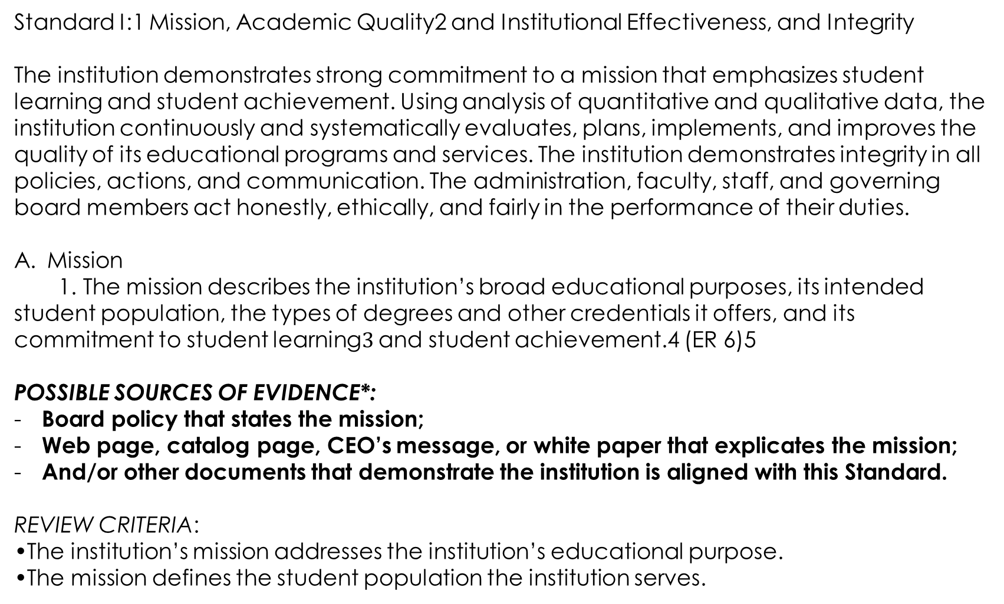
Standard I:1 Mission, Academic Quality2 and Institutional Effectiveness, and Integrity
The institution demonstrates strong commitment to a mission that emphasizes student learning and student achievement. Using analysis of quantitative and qualitative data, the institution continuously and systematically evaluates, plans, implements, and improves the quality of its educational programs and services. The institution demonstrates integrity in all policies, actions, and communication. The administration, faculty, staff, and governing board members act honestly, ethically, and fairly in the performance of their duties.
Mission
1. The mission describes the institution’s broad educational purposes, its intended student population, the types of degrees and other credentials it offers, and its commitment to student learning$3$ and student achievement.4 (ER 6)5
POSSIBLE SOURCES OF EVIDENCE*:
Board policy that states the mission;
Web page, catalog page, CEO’s message, or white paper that explicates the mission;
And/or other documents that demonstrate the institution is aligned with this Standard.
REVIEW CRITERIA:
•The institution’s mission addresses the institution’s educational purpose.
•The mission defines the student population the institution serves.

Slide 12
“When presenting evidence in the ISER, the institution does not need to present every available evidence document imaginable. Institutions should not overwhelm the peer review team with the greatest amount of evidence possible. The goal is to provide the most relevant evidence that will substantiate the institution’s claim that it meets Standards. The institution should aim for quality, not quantity.” (Guide to understanding and Applying Standards, page 34)

